Slide 1
CREATING A LLM APPLICATION

Slide 2
LLMs can reason about wide-ranging topics, but their knowledge is limited to the public data up to a specific point in time that they were trained on.
If you want to work with private data or newer knowledge, then the process of bringing the appropriate information and inserting it into the model prompt is known as Retrieval Augmented Generation (RAG).

Slide 4
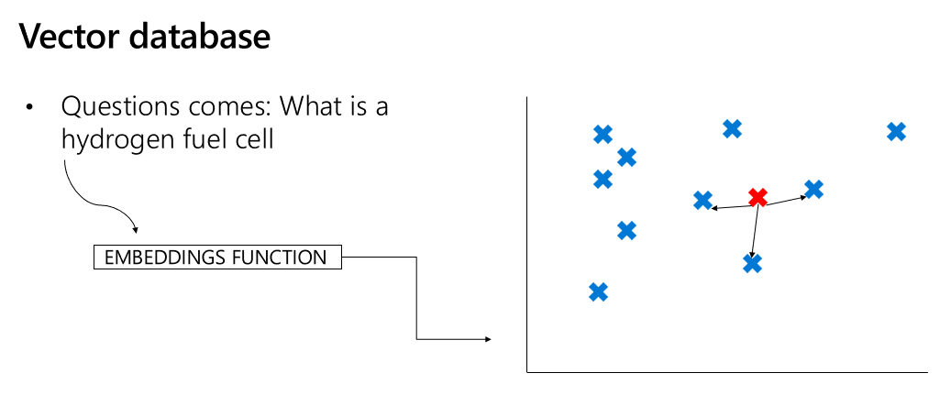

Slide 5
VECTOR DB
DATA
CHUNKS
Generate Embeddings

Slide 6
VECTOR DB
Generate Embeddings
user
LLM
question
answer
PROMPT

